Slide 1
Functions and Curves
Programming – Math for Games
Last modified 04/02/16 by Sam Cartwright

Slide 2
Contents
Implicit vs Parametric Equations
Polynomials
Hyperbolic Curves
Exponential Curves
Logarithmic Curves
Trigonometric Functions

Slide 3
Using Curves
Understanding curves – what they are and how to use them, allows you to manipulate numbers in interesting ways.
This lets us control the objects in our games in many ways

Slide 4
Implicit vs Parametric Curves
There are two main kinds of functions
Implicit
Parametric

Slide 5
Implicit Functions
Implicit functions define a rule
$x + y = 0$is an implicit function.
It defines a rule that states that if you take any x and y, and add them together, if the result is 0, they are part of the function.

Slide 6
Implicit Functions
(3,4) = 3+4 = 7
(-4,4) = -4+4 = 0
(4,-1) = 4-1 = 3

Slide 7
Parametric Functions
Parametric functions, however, take in a parameter and return a value based on that parameter.
$f(x) = −x;$

Slide 8
Parametric Functions
f(-4) = 4
f(3) = -3

Slide 9
Example
Basic parametric functions are useful any time you want to control a variable that changes based on a single float
Color
Position
Scale
AI metrics (anger, fear, awareness)
Anything based off time

Slide 10
Important Ranges
The range from [0-1] and [-1,1] are hugely important
When variables are in this range they are called normalized.
Normalized values are important because they can be used as a percentage or a weighting on other values.
If you want to use a function to evaluate a value between 0 and 85, you can compute the function for the range [0-1] and then multiply by 85.

Slide 11
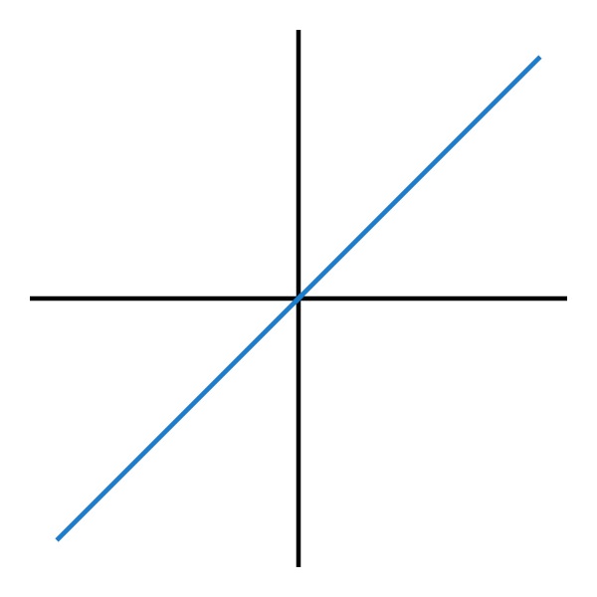
Linear Function
Linear functions are the simplest kind of function we can make
$f(x) = x$

Slide 12

[0-1] Range

Slide 13
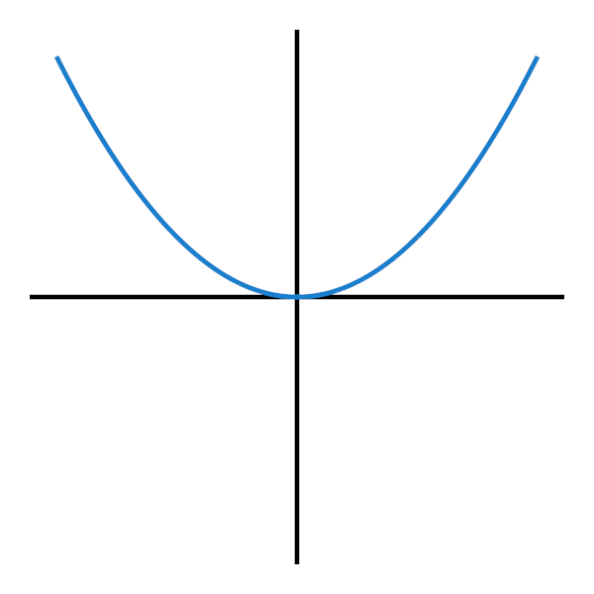
Quadradic Function
Quadratic functions are the next kind of function we will look at.
$f\left(x\right)= { x}^{2}$

Slide 14
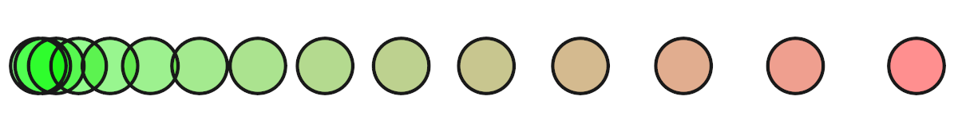
[0-1] range
Notes:
Make not of the fact that it eases in nicely

Slide 15
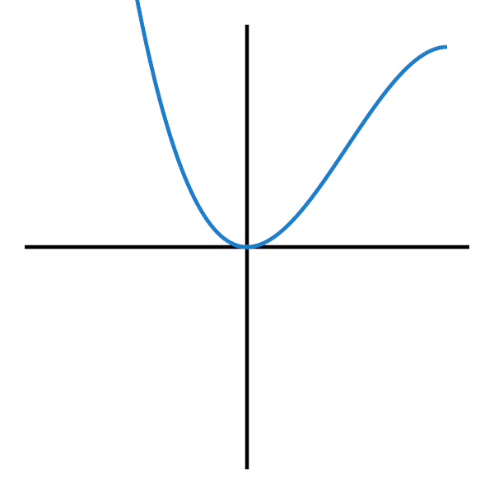
Flipping normalized functions
If you’re looking at a normalized function, its very easy to flip values.
Change x to 1-x
$f\left(x\right)= { 1 −(1 − x)}^{2}$

Slide 16
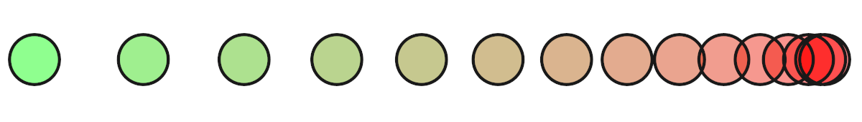
[0-1] range

Slide 17
Polynomial Functions
We can exaggerate the effect by raising to higher powers.
The flipped version works the same as well
$f\left(x\right)= { x}^{3}$
$f\left(x\right)= { x}^{4}$
$f(x) = { x}^{5}$

Slide 18
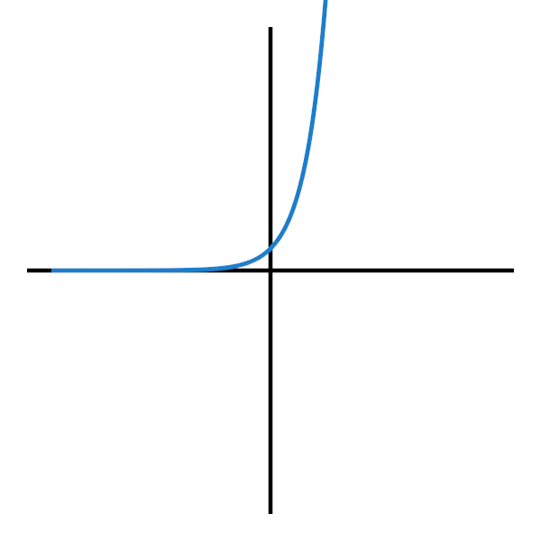
Exponential Functions
$f(x) =e^{x}$
For an even further exaggerated version, we can look at the exponential graph

Slide 19
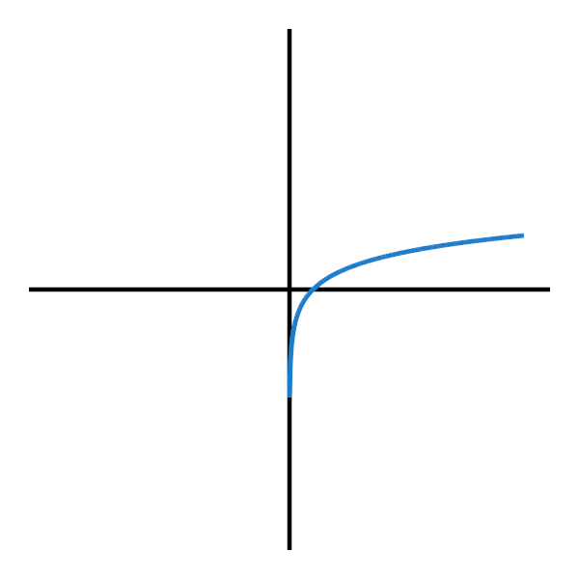
Logarithmic Functions
$f(x) = ln⁡(x)$
The inverse effect of the exponential function, we can use the logarithmic function.

Slide 20
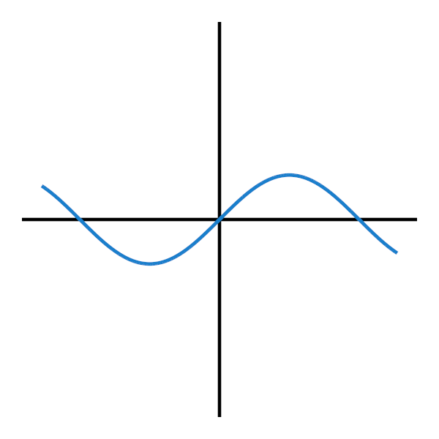
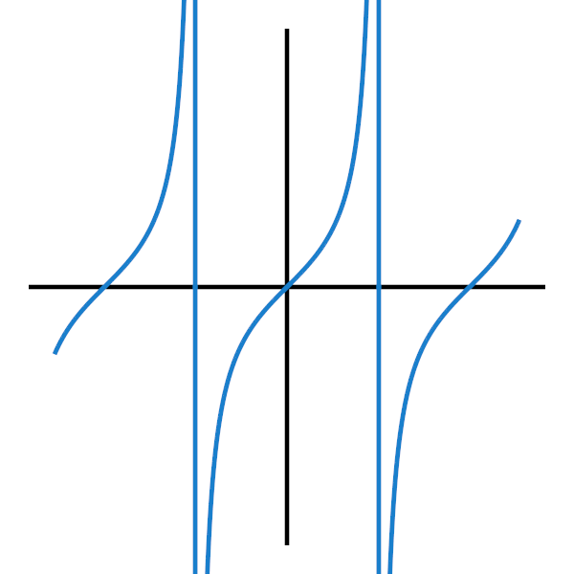
Trigonometric Functions
$f\left(x\right)= sine\left(x\right)$
$f(x) = cosine(x)$
$f(x) = tan⁡(x)$

Slide 21
Trigonometric Functions
The trigonometric functions are very useful for causing periodic repetitions
We can change the frequency of the repetition by multiplying x inside the function
$f\left(x\right)= sine\left(x ∗10\right)$
We can change the amplitude of the repetition by multiplying outside the function
$f\left(x\right)= cosine\left(x\right)∗10$

Slide 22
Combining Functions
Its very easy to modify and combine these functions
You can add them together
Multiply them to scale them
Add to the x variable to shift them left and right
To illustrate, lets look at creating a bounce function
Again, we’ll focus on only the [0-1] range

Slide 23
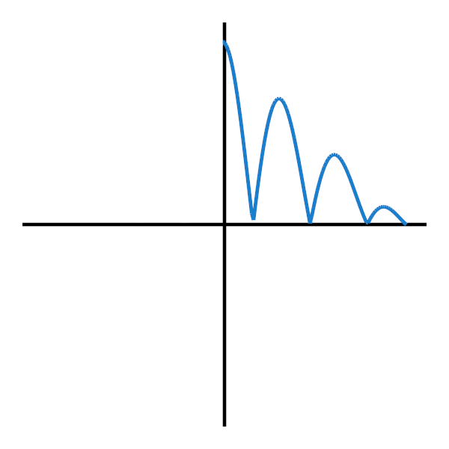
The bounce function

Slide 24
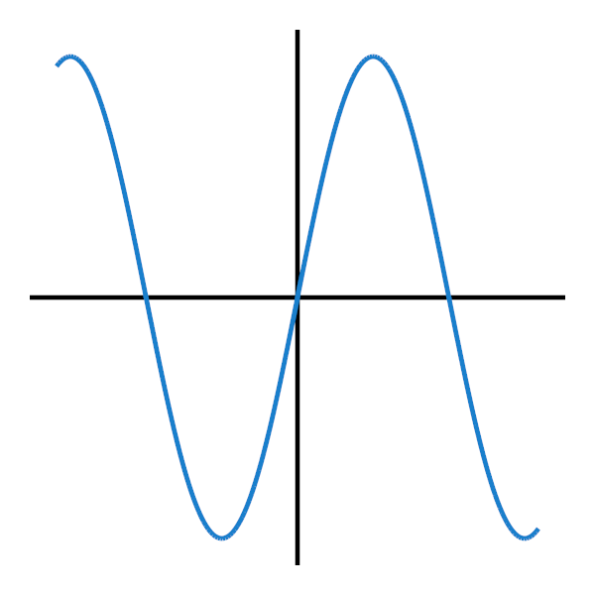
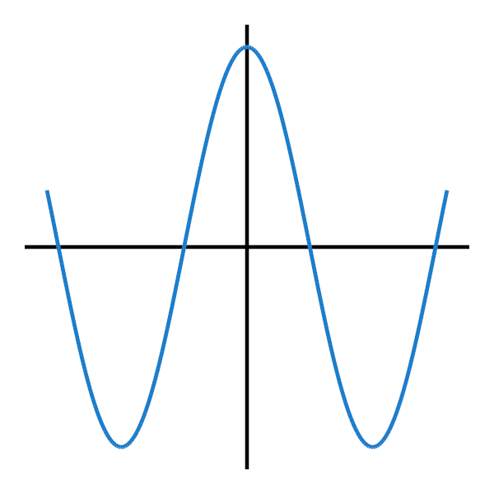
Building the bounce function
First, looking at what we want to create, we want a repeating up/down movement.
For this we need to use sin or cos.
We would like our bounce to start at the top, and decrease over time, so we’ll go with cosine
$f(x) = cosine(x)$

Slide 25
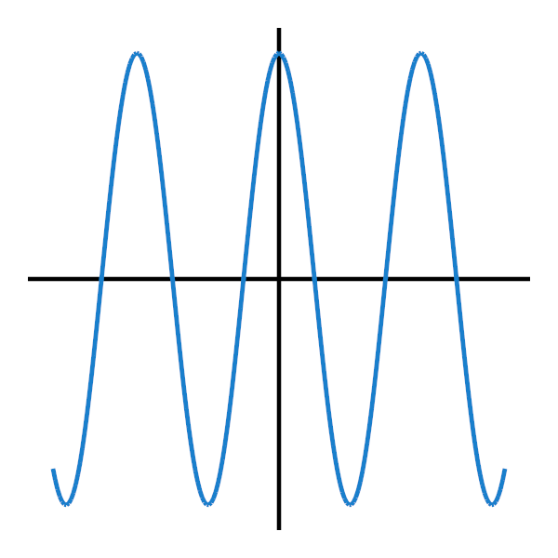
Building the bounce function
Next, we would like it to bounce several times, so we’ll increase the frequency of the cosine
$f(x) = cosine(x∗10)$

Slide 26
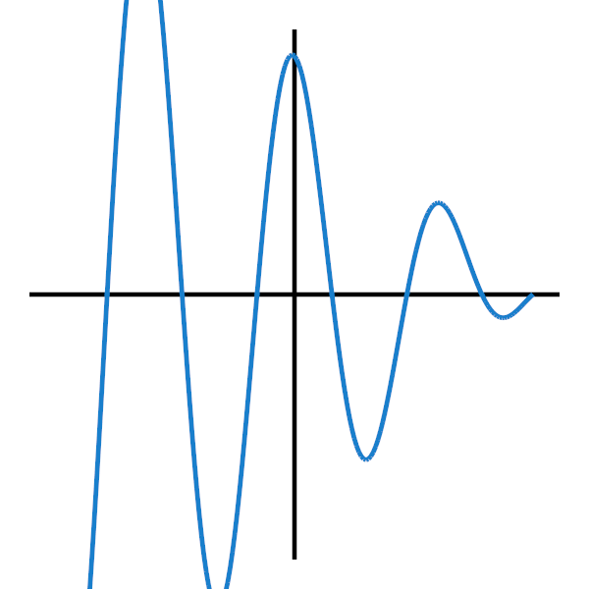
Building the bounce function
Now, we’d like the cosine function to decrease in size over time.
To do this we want to change the amplitude such that it is high at 0 and low at 1
We can achieve this by multiplying by $1−x$
$f\left(x\right)= cosine\left(x∗10\right)∗(1−x)$

Slide 27
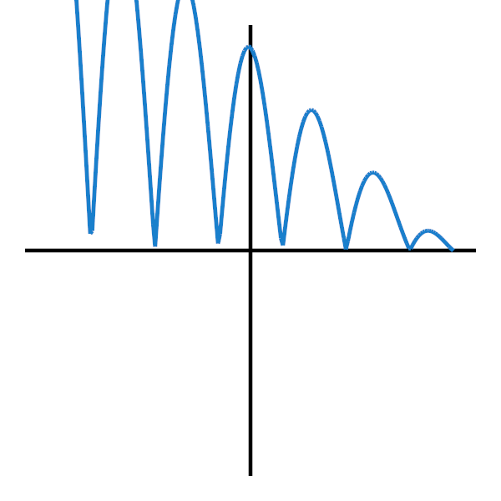
Building the bounce function
We’re almost there, now we just need to add the actual bounce.
We want the curve to start going up instead of going below the x axis
We can just use the absolute value!
$f\left(x\right)=|cosine\left(x∗10\right)∗\left(1−x\right)|$

Slide 28
Building the bounce function
Ignoring anything where x < 0, we get our bounce function

Slide 29
Summary
Using these graphs gives you a lot more power and can let you modify values in your games into behaving the way you want
The 0-1 and the -1-1 ranges are hugely useful
You can build and combine graphs into almost any shape

Slide 30
References
Eric Lengyel, 2011. Mathematics for 3D Game Programming and Computer Graphics, Third Edition. 3rd Edition. Cengage Learning PTR.
R Penner. 2016. Easing Equations. [ONLINE] Available at: http://gizma.com/easing/. [Accessed 04 February 2016].

